Slide 1

Data Mining project on Hepatitis C effects
Rym Barkaoui
Mohamed Seffar

Slide 2
Outline
Introduction
Presentation of Data
Data preparation : Handling Missing Datas
Data mining goal
Evaluation
Conclusion

Slide 3
Presentation
Hepatitis C
infectious disease
Asymptomatic
Lead to liver failure, liver cancer or life-threatening esophageal and gastric varices

Slide 4
Dataset
@relation 'hepatitis-domain'
@attribute 'AGE' integer
@attribute 'SEX' { 2, 1}
@attribute 'STEROID' { 1, 2}
@attribute 'ANTIVIRALS' { 2, 1}
@attribute 'FATIGUE' { 2, 1}
@attribute 'MALAISE' { 2, 1}
@attribute 'ANOREXIA' { 2, 1}
@attribute 'LIVER_BIG' { 1, 2}
@attribute 'LIVER_FIRM' { 2, 1}
@attribute 'SPLEEN_PALPABLE' { 2, 1}
@attribute 'SPIDERS' { 2, 1}
@attribute 'ASCITES' { 2, 1}
@attribute 'VARICES' { 2, 1}
@attribute 'BILIRUBIN' real
@attribute 'ALK_PHOSPHATE' integer
@attribute 'SGOT' integer
@attribute 'ALBUMIN' real
@attribute 'PROTIME' integer
@attribute 'HISTOLOGY' { 1, 2}
@attribute 'Class' { 'DIE', 'LIVE'}

Slide 5
Handling missing data’s
Mean/Mode method
Mean when numeric
Mode when nominal

Slide 6
Data mining goals:
Is a new patient more likely to die or to live based on his “parameters”?
Algorithm chosen : J48

Slide 7
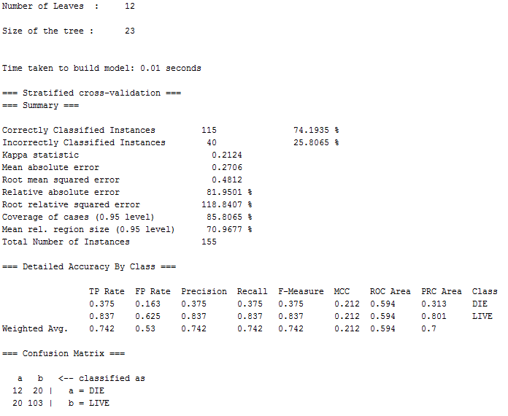
Rate of correctly classified instances: 75%

Slide 8
Results
After running j48 we obtain the following decision tree.

Slide 10
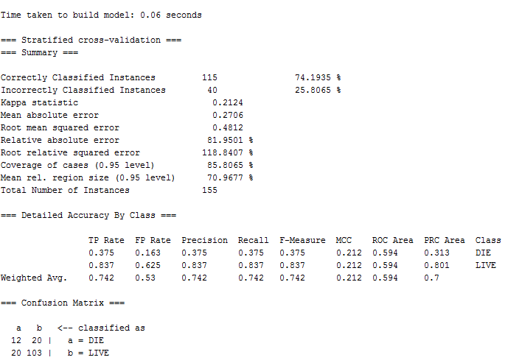
Evaluation

Slide 11
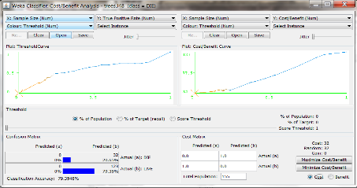
Evaluation
110 correctly classified instances out of 155 which corresponds to 74%.
We have a mean absolute error of 82%
Cost/Benefit

Slide 12
Evaluation Unbalanced Data
Classes have unequal frequency: around 80% of class live and 20% of the class die. This is a common problem on medical studies.
Difficult to evaluate our classifier method.
The solution is to build a balanced set of data and to re-classify our data.
Randomly removing instance of the majority class until the two classes are balanced.

Slide 13
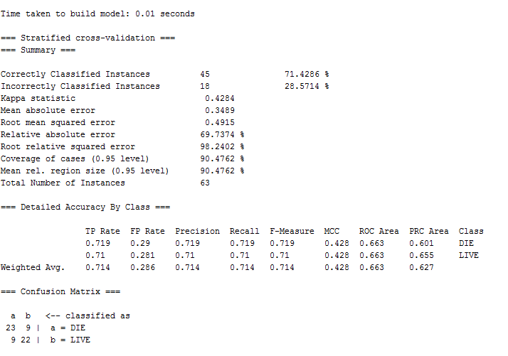
Evaluation
Our balanced set of data give us different results

Slide 14
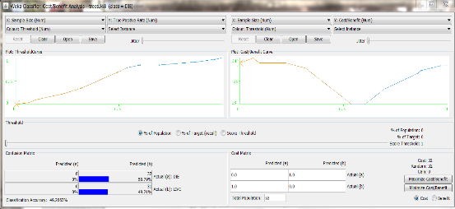
Evaluation
The balanced set reduce the relative absolute error. But the accuracy of the classification drop (79% to 49%)

Slide 15
Conclusion
We have to be careful when working with a medical dataset
Replacing missing data
Working with unbalanced data live/die

Slide 16
Conclusion
We have to be careful when working with a medical dataset
Replacing missing data
Working with unbalanced data live/die

